Slide 1
Seminar
Week 2 seminar| Human and Computer Interaction

Slide 2
Session Outline
In this week’s seminar session, you will practice the following concepts from the lecture session:
Apply Norman’s design principles in an HCI product (i.e. web design).
Apply usability in an HCI product (i.e. web design).
The seminar is structured into 2 group activities:
Norman’s design principles applied to web design (60 minutes).
Usability applied to web design (60 minutes).

Slide 3
Activity 1: Review of a web design
Goal of the activity:
Design a simple web page (e.g., a homepage for a coffee shop) applying Norman’s design principles and usability concepts.
Materials Needed:
Paper and pencils for sketching
Access to a web design tool (e.g., Figma, Adobe XD) – You can use pen and paper now
The summary slide for reference

Slide 4
Activity 1: Review of a web design
Step-by-step instructions:
Recap of key concepts from the lecture (5 minutes)
You may consult the lecture materials or conduct further research.
Ensure you review good examples of HCI design of a similar scenario you are applying.
Sketching (or using a wireframe tool): Annotate and justify your sketching – link any relevant aspect to the HCI design principles (20 minutes)
Design: Always think, “how will I be able to measure my progress? How would I know if my design is good?” (20 minutes)
Self-Assessment and Teacher Feedback (10 minutes)
Peer feedback (5 minutes)

Slide 5
Recap: Norman’s Design Principles (5 minutes)
Principle | Description
Feedback | Providing users with immediate and clear responses to their actions
Affordances | Design elements that indicate how they can be used.
Consistency | Ensuring that design elements behave the same way across the interface.
Error Prevention and Recovery | Designing systems to prevent errors and allowing easy recovery from them.
Scalability and Responsiveness | Ensuring the interface performs well across various devices and screen sizes.
Accessibility | Designing interfaces that are usable by people with a wide range of abilities and disabilities.
Load Time Optimization | Reducing the time it takes for an interface to load.
Mapping | a design in which the system’s controls represent or correspond to the desired outcome. When controls map to the actions that will result, systems are faster to learn and easier to remember.

Slide 6
Recap: Norman’s design principles
Discuss examples of good and bad web design in terms of these principles:
Norman’s design principles
Feedback
Affordances
Consistency
Error Prevention and Recovery
Scalability and Responsiveness
Accessibility
Load Time Optimization
Intuitive design
Clear Instructions
minimalistic approach
User-Friendly Interface
Usability in Web Design
Simplicity in Web Design
Effectiveness
Efficiency
Satisfaction
Aiming at
Minimal design
Clear hierarchy
Straightforward layout

Slide 7
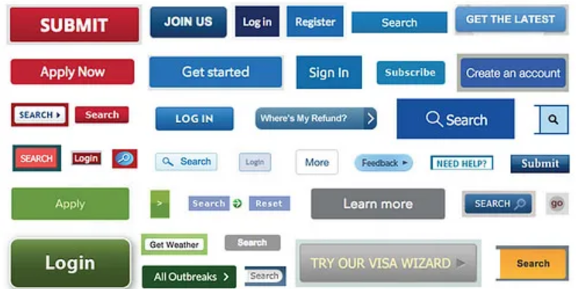
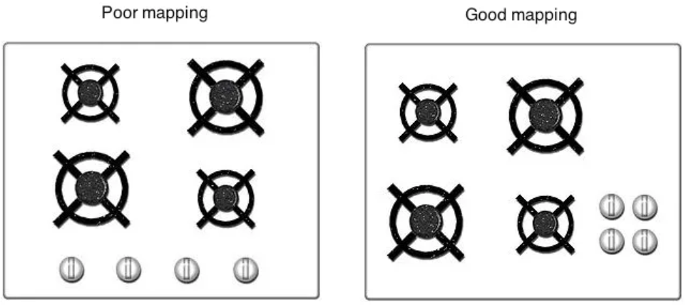
Recap: Examples in real world scenario
Figure 1: Example of inconsistency
Figure 2: example of good mapping and poor mapping
Image source: Don Norman’s Principles of Interaction Design | by Sachin Rekhi | Medium

Slide 8


Recap: Examples in real world scenario
Figure 3: example of affordance
Figure 4: example of accessibility
Image source: Don Norman’s Principles of Interaction Design | by Sachin Rekhi | Medium

Slide 9
Sketching (20 minutes)
Create a rough sketch of your web page on paper.
Ensure that you incorporate each of Norman’s principles and usability concepts.
Highlight elements that provide feedback, affordances, and ensure consistency.
You may also use a wireframe tool.

Slide 10
Designing (20 minutes)
Use a web design tool to create a digital version of your sketch.
Focus on implementing scalability, responsiveness, and load time optimization.
Make the design accessible and minimize load time.

Slide 11
Self-Assessment and Teacher Feedback (10 minutes)
As a group:
Use the table listing Norman’s principles and usability concepts to review your design.
Did you provide immediate and clear feedback for user actions?
Are affordances clear for all interactive elements?
Is the design consistent throughout?
Have you included mechanisms for error prevention and recovery?
Is your design scalable and responsive across devices?
Is the design accessible to users with disabilities?
Have you optimized load time?

Slide 12
Peer feedback (5 minutes)
Pair up with another group to review each other’s designs.
Provide feedback based on how well Norman’s principles and usability concepts are applied.
What have you learned from this activity? Share your ideas with the rest of the group.

Slide 13
Activity 2: Apply Usability to web design
Goal of the activity: Apply Usability in HCI product (i.e. Web design)
Objective: Evaluate and enhance the usability of the page you designed in the first activity using usability goals and principles.
Resources to use:
Clear understanding of what is a Usability HCI design
Paper and pencils for note-taking
Access to a web design tool (e.g., Figma, Adobe XD) – Or using pen and paper for this time.
Initial design and refined version from the first activity
Usability goals and principles checklist
Access to a usability testing tool or survey platform (e.g., Google Forms, UsabilityHub)

Slide 14
Activity 2: Apply Usability to web design
Step-by-step guidelines
Introduction (10 minutes)
Creating a Usability Test Plan (15 minutes)
Conducting the Usability Test (15 minutes)
Analysing Results and Refining Design (10 minutes)

Slide 15
Introduction to Usability (10 minutes)
Usability is a pillar in successful HCI design, or any design.
In the previous activity, you already considered Usability as part of Norman’s design principles. Now, you will need to measure and evaluate how successful the usability of your design is. Hence, you will measure and test your design‘s usability.
Have a quick reading about usability in HCI design using the following source:
INTERACTION DESIGN FOUNDATION, 2024. What is Usability? Interaction Design Foundation. Available from: https://www.interaction-design.org/literature/topics/usability [Accessed 24 June 2024]
Discuss with your group the importance of user experience goals such as satisfaction, enjoyment, and motivation.

Slide 16
Creating a Usability Test Plan (15 minutes)
Define specific tasks that users should complete in your design (e.g., find the menu, place an order).
Develop a questionnaire or survey to gather user feedback on the design's usability (e.g., How easy was it to find the menu?) ➔ you can find open source templates such as this website:
VANDER HEYDEN, N., 2023. 12 Usability Testing Templates: Checklist & Examples. Marker.io. Available from: https://marker.io/blog/usability-testing-template [Accessed 24 June 2024]
Prepare a checklist for observing user interactions, focusing on usability goals and principles.

Slide 17
Conducting the Usability Test (15 minutes)
Pair up with another group and take turns being the tester and the observer:
The tester will perform the predefined tasks (perform a demo by explaining it and walking it through) on the other group’s web design
At the same time, the observer takes notes on any issues or difficulties encountered.
After the walkthrough, the observer will fill out the questionnaire or survey.

Slide 18
Analysing Results and Refining Design (10 minutes)
With your group, answer the following questions about your design, focusing on usability goals and principles:
Is the design effective and efficient to use?
Does it provide good utility and is it easy to learn and remember?
Is the design safe and ergonomic?
Is it accessible to users with disabilities?
Does the design provide a satisfying and enjoyable user experience?
Identify common issues and areas for improvement based on usability goals and user experience feedback.
Update your web design to address the identified issues and enhance usability.

Slide 19
Session recap
In today’s session, you worked on:
Applying Norman’s design principles to an HCI product (i.e. web design).
Applying usability in an HCI product (i.e. web design).
If you need some extra practice, you can use the resources listed in each activity, and there are materials available for self-study in the VLE platform.

Slide 20
References
INTERACTION DESIGN FOUNDATION, 2024. What is Usability? Interaction Design Foundation. Available from: https://www.interaction-design.org/literature/topics/usability [Accessed 24 June 2024]
VANDER HEYDEN, N., 2023. 12 Usability Testing Templates: Checklist & Examples. Marker.io. Available from: https://marker.io/blog/usability-testing-template [Accessed 24 June 2024]

